Slide 1
Data Privacy protection models

Slide 2
Anonymous Data System
Informally, An anonymous data system is one that releases entity-specific data such that particular properties, such as identity, of the entities that are the subject of the data cannot be inferred from the released data. [1]

Slide 3
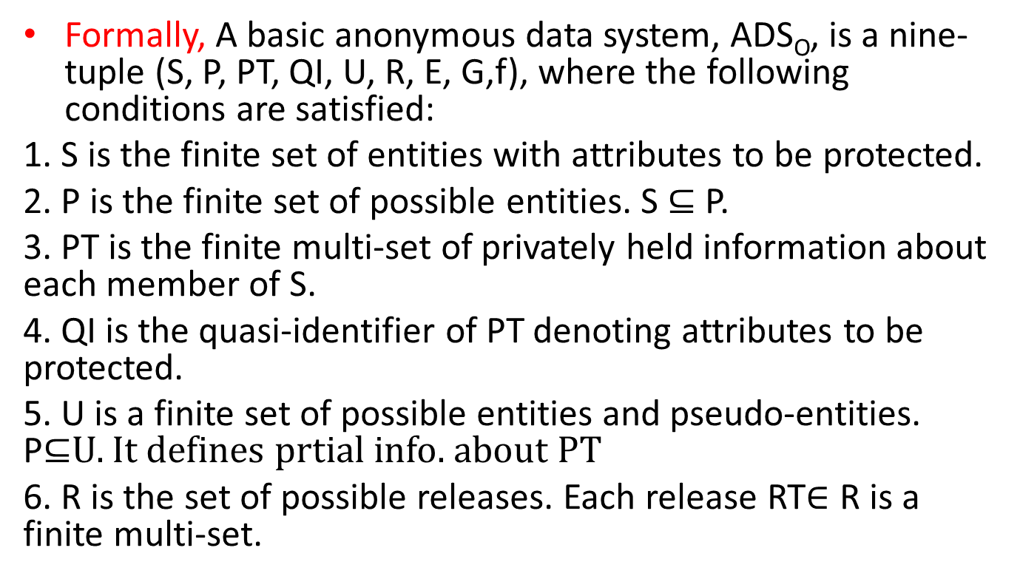
Formally, A basic anonymous data system, ADS_{O}, is a nine-tuple (S, P, PT, QI, U, R, E, G,f), where the following conditions are satisfied:
1. S is the finite set of entities with attributes to be protected.
2. P is the finite set of possible entities. S $⊆$P.
3. PT is the finite multi-set of privately held information about each member of S.
4. QI is the quasi-identifier of PT denoting attributes to be protected.
5. U is a finite set of possible entities and pseudo-entities. P⊆U. It defines prtial info. about PT
6. R is the set of possible releases. Each release RT$∈$R is a finite multi-set.

Slide 4
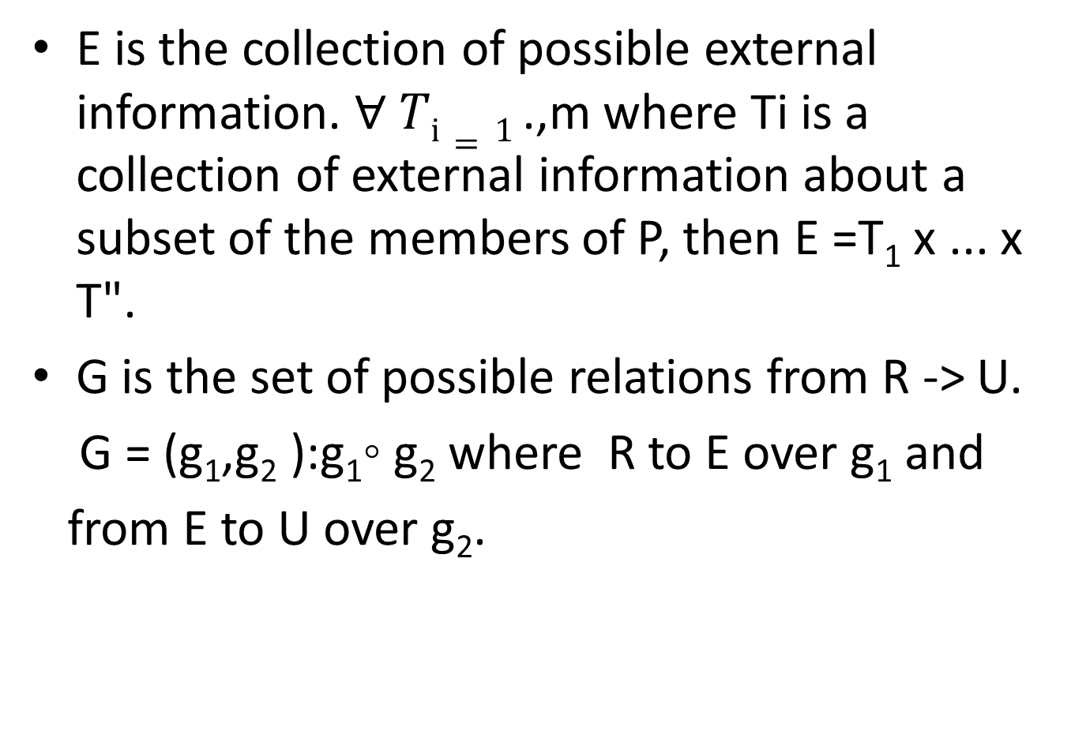
E is the collection of possible external information. $∀ Ti=1$.,m where Ti is a collection of external information about a subset of the members of P, then E =T₁ x ... x T".
G is the set of possible relations from R -> U.
G = (g₁,g₂ ):g₁◦ g₂ where R to E over g₁ and
from E to U over g₂.

Slide 5
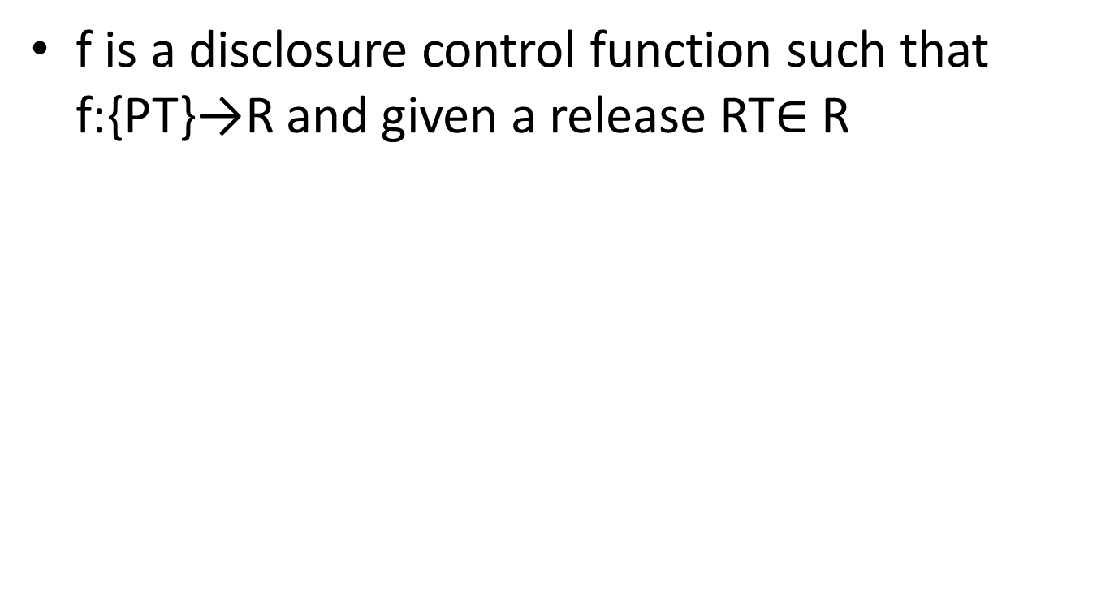
f is a disclosure control function such that f:{PT}→R and given a release RT$∈$ R

Slide 6
Disclosure control function
Disclosure control function (Statistical disclosure control), seeks to protect data in such a way that they can be publicly released and mined without giving away private information that can be linked to specific individuals or entities.
Mathematically, Given a table T and a finite set of tables B, I say f is a disclosure control function on {T}. That is, f: {T} -> B is a disclosure control function .

Slide 7
Protection models
There are three protection models associated with data privacy
Null Map
K-Map
Wrong Map

Slide 8
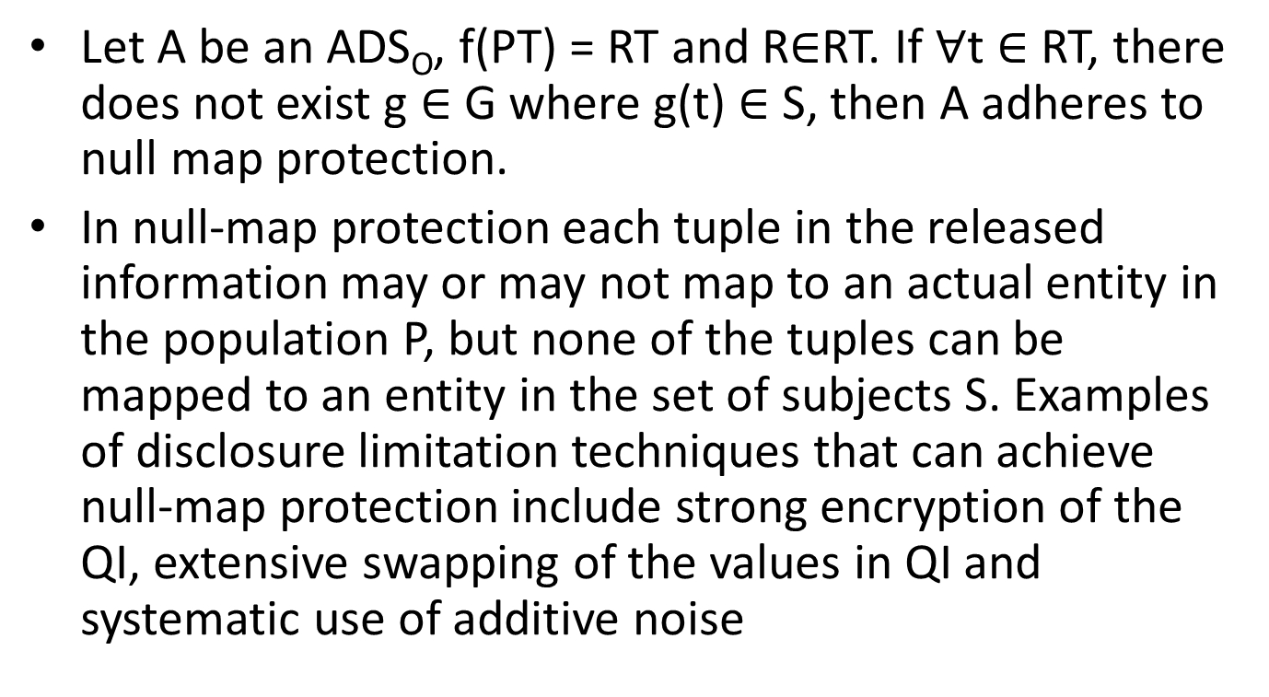
Null Map
Let A be an ADS_{O}, f(PT) = RT and R$∈$RT. If $∀$t$∈$RT, there does not exist g$∈$G where g(t) $∈$S, then A adheres to null map protection.
In null-map protection each tuple in the released information may or may not map to an actual entity in the population P, but none of the tuples can be mapped to an entity in the set of subjects S. Examples of disclosure limitation techniques that can achieve null-map protection include strong encryption of the QI, extensive swapping of the values in QI and systematic use of additive noise

Slide 9
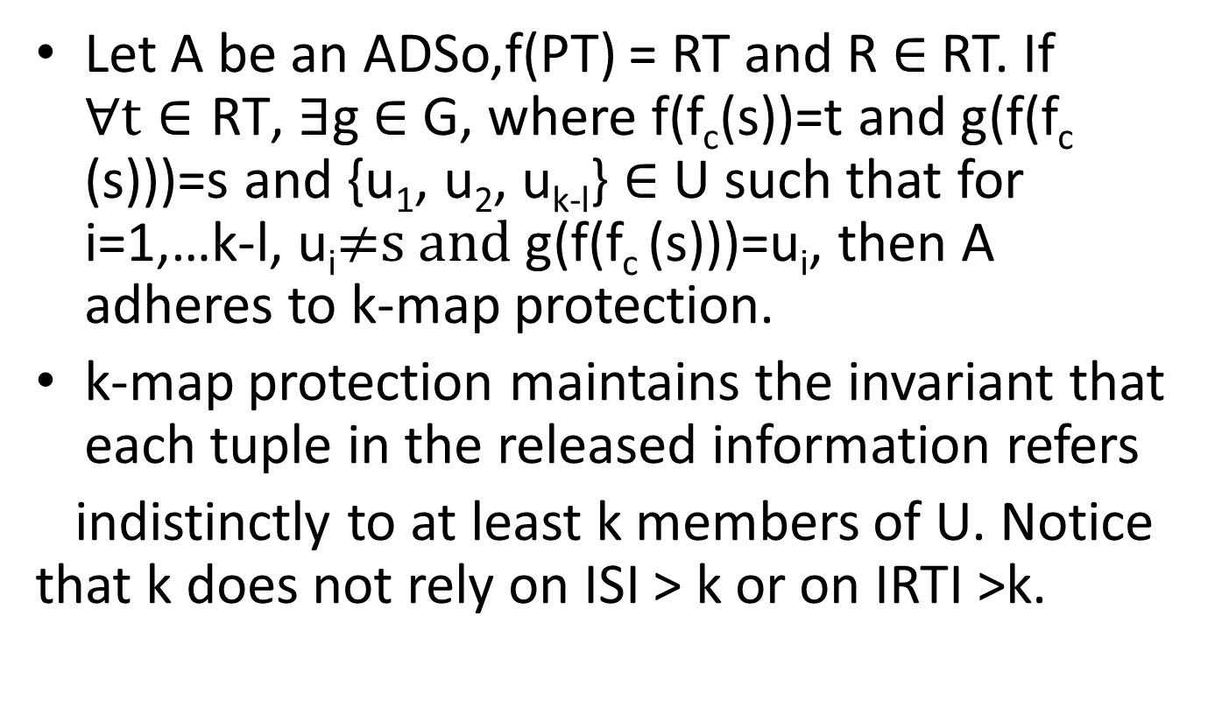
K-map protection
bkgfofkhoyojkbmjknm,kmljgkji

Slide 10
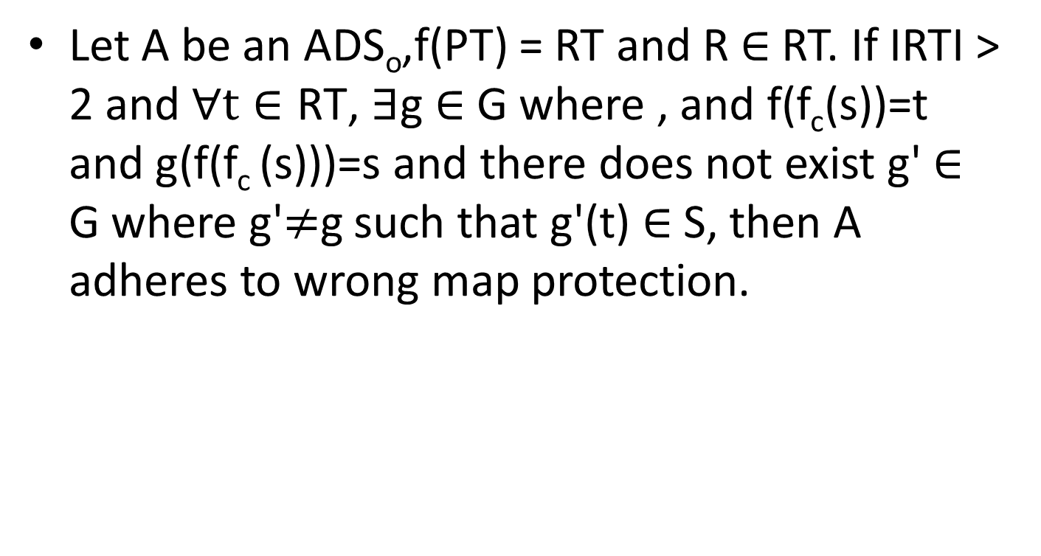
Wrong Map
Let A be an ADS_{o},f(PT) = RT and R$∈$RT. If IRTI > 2 and $∀\text{t}∈\text{R}\text{T}$, $∃$g$∈$ G where , and f(f_{c}(s))=t and g(f(f_{c} (s)))=s and there does not exist g'$∈$G where g'≠gsuch that g'(t)$∈$S, then A adheres to wrong map protection.

Slide 11
Wrong map protection requires each tuple in the released information to be identified to only one entity in subjects but that entity is not the entity to which the original information was collected. The ADS_{O} requirement ensures the values with attributes outside QI contained in the release are not the same as those originally collected. Notice if there exists only one entity in the subjects S, then wrong-map protection cannot be done and with only two entities in S, the release is compromised.

Slide 12
Inferring entity identities
Inference control in statistical databases, also known as Statistical Disclosure control, seeks to protect statistical data in such a way that they can be publicly released and mined without giving away private information that can be linked to specific individuals or entities.
The protection provided by SDC techniques normally entails some degree of data modification, which is an intermediate option between no modification (maximum utility, but no disclosure protection) and data encryption (maximum protection but no utility for the user without clearance)

Slide 13
Following are the techniques [1,2]
Deidentification: De-identified data result when all explicit identifiers such as name, address, and phone number are removed, generalized, or replaced with a made up alternative.
This process is not sufficient to render data anonymous because combinations of attributes often combine uniquely to re-identify individuals.
2. Suppression: sensitive information and all information that allows the inference of sensitive information are simply not released.

Slide 14
Suppression can drastically reduce the quality of the data, and in the case of statistical use, overall statistics can be altered, rendering the data practically useless.
3. Encryption: is a process of making values secret by replacing one value with another in such a way that certain properties with respect to reversing the process are maintained.
4. Swapping Values: It involves exchanging the values associated with an attribute in two tuples where the value from the first tuple becomes the value for the second and vice versa.

Slide 15
5. Generalization : It replaces a value with a more general, less specific alternative.
6. Substitution : It replaces a value with another value in its equivalence class. Sampling restricts the number of tuples that will be released.
7. Scrambling: It is a reordering of tuples and is used when the order of appearance of tuples in a release allows inference.
8. Changing outliers to medians : requires detecting unusual values and replacing them with values that occur more commonly.

Slide 16
A classification of microdata protection methods
A microdata set V can be viewed as a file with n records, where each record contains m attributes on an individual respondent. The attributes can be classified in four categories which are not necessarily disjoint
Identifiers. These are attributes that unambiguously identify the respondent. Examples are the passport number, social security number
Quasi-identifiers or key attributes. These are attributes which identify the respondent with some degree of ambiguity. address, gender, age.

Slide 17
Confidential outcome attributes. These are attributes which contain sensitive information on the respondent. Examples are salary, religion, political affiliation.
Non-confidential outcome attributes. Those attributes which do not fall in any of the categories above.

Slide 18
Microdata protection methods can generate the protected microdata set V’.
Either by masking original data, i.e. generating V’ a modified version of the original microdata set V.
or by generating synthetic data V’ that preserve some statistical properties of the original data V.

Slide 19
Masking methods can in turn be divided in two categories depending on their effect on the original data
Perturbative: The microdata set is distorted before publication. In this way, unique combinations of scores in the original dataset may disappear and new unique combinations may appear in the perturbed dataset; such confusion is beneficial for preserving statistical confidentiality.
Non-perturbative: Non-perturbative methods do not alter data; rather, they produce partial suppressions or reductions of detail in the original dataset. Global recoding, local suppression and sampling are examples of non-perturbative masking.

Slide 20
Perturbative masking methods
Additive Noise: The noise additions algorithms in the literature are masking by uncorrelated noise addition, masking by correlated noise addition, masking by noise addition and linear transformation[3] and masking by noise addition and nonlinear transformation [4].
Microaggregation: The rationale behind microaggregation is that confidentiality rules in use allow publication of microdata sets if records correspond to groups of k or more individuals, where no individual dominates (i.e. contributes too much to) the group and k is a threshold value.

Slide 21
Data swapping and rank swapping: Data swapping was originally presented as an SDC method for databases containing only categorical attributes [5,2]. The basic idea behind the method is to transform a database by exchanging values of confidential attributes among individual records. Records are exchanged in such a way that low-order frequency counts or marginals are maintained. Another variant of data swapping for microdata is rank swapping, can also be used for any numerical attribute [6,2].

Slide 22
Rounding: Rounding methods replace original values of attributes with rounded values. For a given attribute Xi , rounded values are chosen among a set of rounding points defining a rounding set (often the multiples of a given base value).
Resampling: Originally proposed for protecting tabular data [7,8].

Slide 23
PRAM : The Post-RAndomization Method (PRAM, [9]) is a probabilistic, perturbative method for disclosure protection of categorical attributes in microdata files. In the masked file, the scores on some categorical attributes for certain records in the original file are changed to a different score according to a prescribed probability mechanism, namely a Markov matrix. The Markov approach makes PRAM very general, because it encompasses noise addition, data suppression and data recoding.

Slide 24
Non-perturbative masking methods
Sampling: Sampling methods are suitable for categorical microdata, but for continuous microdata they should probably be combined with other masking methods.
Global recoding: This method is also sometimes known as generalization. This technique is more appropriate for categorical microdata, where it helps disguise records with strange combinations of categorical attributes.
Top and bottom coding : Top and bottom coding is a special case of global recoding which can be used on attributes that can be ranked, that is, continuous or categorical ordinal. The idea is that top values (those above a certain threshold) are lumped together to form a new category. The same is done for bottom values

Slide 25
Local suppression: Certain values of individual attributes are suppressed with the aim of increasing the set of records agreeing on a combination of key values.

Slide 26
References
[1] Sweeney, Latanya. Computational disclosure control: a primer on data privacy protection. Diss. Massachusetts Institute of Technology, 2001.
[2] Domingo-Ferrer, Josep. "A survey of inference control methods for privacy-preserving data mining." Privacy-preserving data mining. Springer US, 2008. 53-80.
[3] J. J. Kim. A method for limiting disclosure in microdata based on random noise and transformation. In Proceedings of the Section on Survey Research Methods, pages 303–308, Alexandria VA, 1986. American Statistical Association.
[4] G. R. Sullivan. The Use of Added Error to Avoid Disclosure in Microdata Releases. PhD thesis, Iowa State University, 1989.
[5] T. Dalenius and S. P. Reiss. Data-swapping: a technique for disclosure control (extended abstract). In Proc. of the ASA Section on Survey Research Methods, pages 191–194, Washington DC, 1978. American Statistical Association.
[6] R. Moore. Controlled data swapping techniques for masking public use microdata sets, 1996. U. S. Bureau of the Census, Washington, DC, (unpublished manuscript).
[7] G. R. Heer. A bootstrap procedure to preserve statistical confidentiality in contingency tables. In D. Lievesley, editor, Proc. of the International Seminar on Statistical Confidentiality, pages 261–271, Luxemburg, 1993. Office for Official Publications of the European Communities.
[8] J. Domingo-Ferrer and J. M. Mateo-Sanz. On resampling for statistical confidentiality in contingency tables. Computers & Mathematics with Applications, 38:13–32, 1999.

Slide 27
[9] J. M. Gouweleeuw, P. Kooiman, L. C. R. J. Willenborg, and P.-P. DeWolf. Post randomisation for statistical disclosure control: Theory and implementation, 1997. Research paper no. 9731 (Voorburg: Statistics Netherlands)

